Slide 1
Rabies in Kazakhstan

Slide 2





Rabies
Deadly zoonotic infectious disease
Limited access to treatment in remote locations
High economic costs

Slide 4
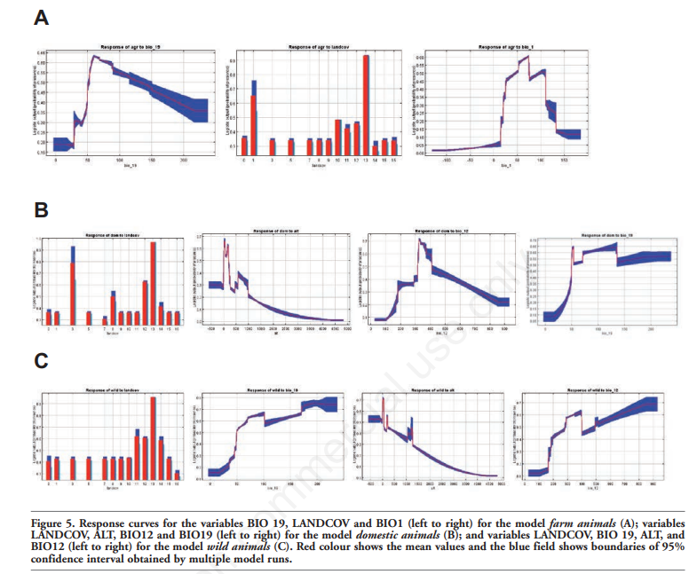
Data Science Method #1
Data Sources: United States Geological Survey, National database of rabies outbreaks in Kazakhstan, WorldClim
Maximum entropy method: to establish a relationship between the rabies outbreaks locations and potential environmental factors

Slide 5
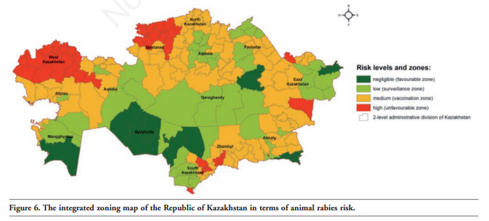
Zoned map shows the territorial distribution of the risk of rabies outbreaks in various areas of Kazakhstan found using the modelling of geological factors

Slide 6
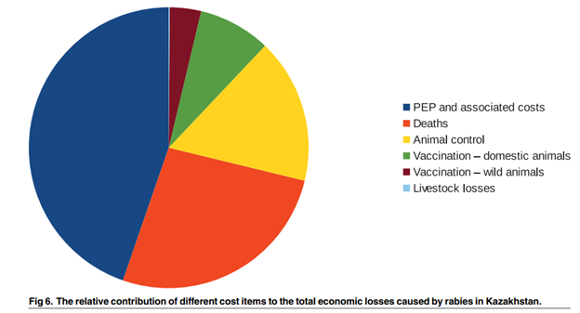
Data Science Method #2
Data Sources: Republican Veterinary Laboratory, Ministry of Agriculture, Veterinary Control, and Monitoring Committee reports
BetaPERT distribution: Usage of uncertainty limits to identify relative contributions of different cost items to the total economic loss caused by rabies

Slide 7
Literature Gap
Diagnostic tests
Effectiveness of vaccines
Research question: how can rabies better be diagnosed in Kazakhstan and what could be done to prevent an outbreak

Slide 8

Research Plan
Testing the hypothesis of the first group of researchers surrounding vaccinations. They suggest that providing vaccines to only dogs and foxes would indirectly protect the livestock. Two groups of similar geographical composition with one under the current vaccine regulations and the other with only dog and fox vaccinations to then compare results.

